Slide 1
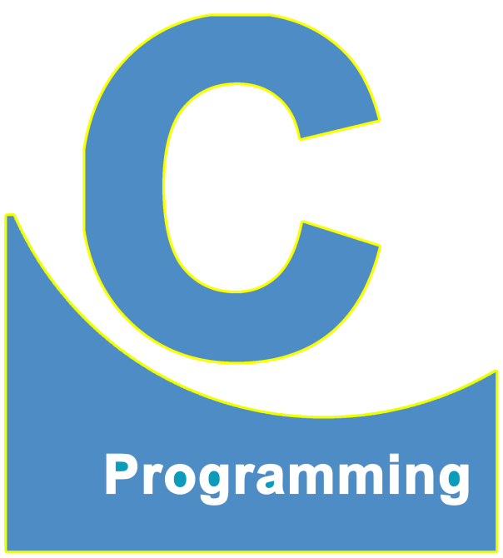
01
02
C Language
Lecture 12
04

Slide 2


Today’s Agenda
01
What are Operators ?
02
Types of Operators
03
Arithmetic Operators

Slide 3
What are Operators ?
What are Operators in programming ?
Operators are those symbols using which we can perform various types
of operations on operands.
For Example:
int a;
a=25;
This line will assign the value 25 to the variable

Slide 4
What are Operators ?
Similarly:
x = y + z ; // This will add y and z and store the result in x
Here ‘y’ and ‘z’ is a Operands and ‘+’ and ‘=‘ is a Operators

Slide 5
Types of Operators
Types Of Operators In C Language
In C language we have multiple types or categories of operators.
We will start with the most common operators which are very basic as well as
very Important for initial programming in C language. We discuss the remaining
operators as and when required.

Slide 6
Types of Operators
To begin with this chapter we will discuss 3 very COMMON CATEGORIES OF
OPERATORS :
Arithmetic Operators
Relational Operators
Logical Operators

Slide 7
Arithmetic Operators
These are those operators in C language, which are used for performing
Mathematical operation on their operands.
In C language, we have just 5 ARITHMETIC OPERATORS:
+ (Arithmetic Addition)
- (Arithmetic Subtraction)
* (Arithmetic Multiplication)
/ (Arithmetic Division) This operator give the quotient
% (Modulo Division) This operator gives the remainder

Slide 8
Arithmetic Operators
What will be the output of the following ?
int a=10,b=3;
1. printf(“%d”,a+b);
2. printf(“%d”,a-b);
3. printf(“%d”,a*b);
13
7
30.

Slide 9
Arithmetic Operators
Here we must remember that in C only * indicated multiplication. C doesn’t take
“ . “ to be multiplication not it takes () for multiplication. That means
Following are wrong :
a.b; // Error
2(a+b) // Error
printf(“%d”,a/b);
not 3.33333 or any other value
3

Slide 10
Arithmetic Operators
The reason for this behavior is that in C/C++/Java there is a special RULE
regarding “/ ” operator. And the Rule is that :
INTEGER/INTERGER is always INTEGER
Printf(“%d”,a%b);
This operator provides us remainder after performing division
1

Slide 11
Guess The Output ?
1.
int a;
a=10/4;
printf(“%d”,a);
Output : 2
Since 10 and 4 both are integers
result will also be an integer
2.
float a;
a=10/4;
printf(“%f”,a);
Output : 2.000000
Although we have stored the result in a
float variable, but since numerator and
denominator are integers, so the
resultant answer will also be an integer

Slide 12
Guess The Output ?
3.
int a;
a=10/4.0;
printf(“%d”,a);
Output : 2
Although 10/4.0 will surely produce
2.5 (internally), but since the variable a
is an integer, so the compiler will
truncate the decimal part ( .5) and will
only assign the integer part to the
variable a
4.
float a;
a=10/4.0;
printf(“%f”,a);
Output : 2.500000
Here we got 2.5, because we are doing
int/float and also we are storing the
result in a float.

Slide 13
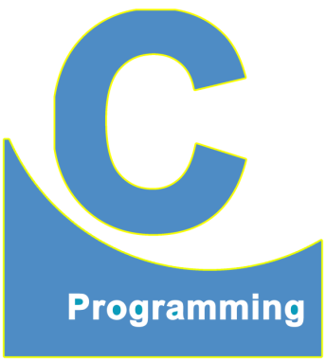
End of Lecture 12
For any queries mail us @: scalive4u@gmail.com
Call us @ : 0755-4271659, 7879165533
Thank you

